Slide 1
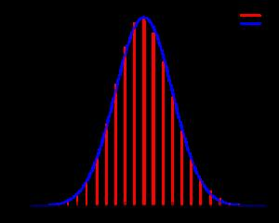
23D The Binomial Distribution
Ch. 15H continued

Slide 2
The Binomial Distribution
-applied to experiments with replacement ONLY(therefore…..independent events only)
-Note: For DEPENDENT events we use the “hypergeometric probability distribution” (Not part of SL course but included for your mathematical enjoyment)
2 Possible outcomes
SUCCESS = the event happens
FAILURE = the event does not happen

Slide 3
The Binomial Distribution
When the experiment is repeated a number (n) of independent trials, we call it a binomial experiment.
Probability for successes (p) is CONSTANT (independent events)
Probability for failure = 1-p (complimentary)
Random variable X = number of successes in n trials

Slide 4
The Binomial Distribution
For n trials r SUCCESSES and n-r failures in an experiment
where r = 0,1,2,3, …………….,n
We call P(X = r) the binomial probability distribution function
NOTE:

Slide 5
NOTE:
Vs.
Why the switch in order?!?!

Slide 6
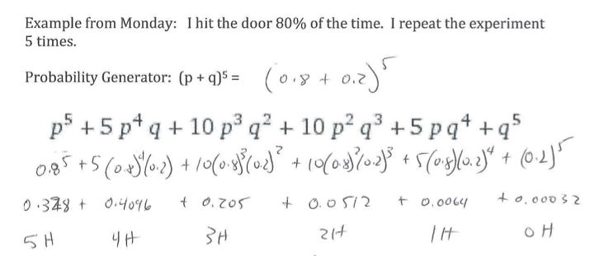
Note WE have to flip to 0,1,2,3,4,5

Slide 7
NOTE:
Vs.
Why the switch in order?!?!

Slide 8
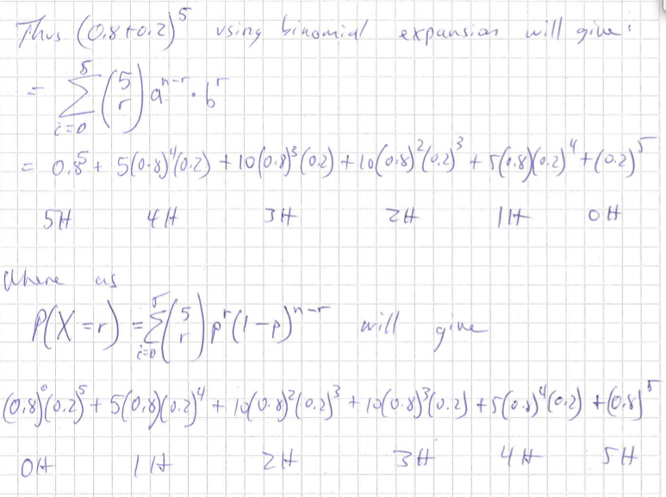
All this does is reverse the order of the expansion……thus for

Slide 9
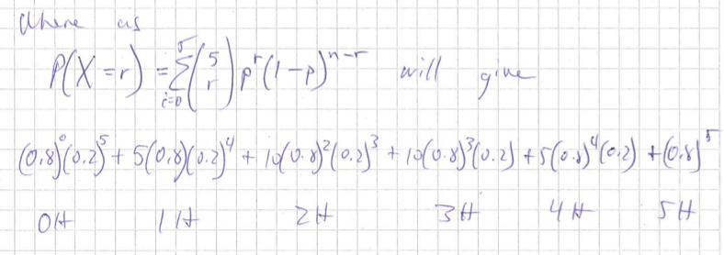
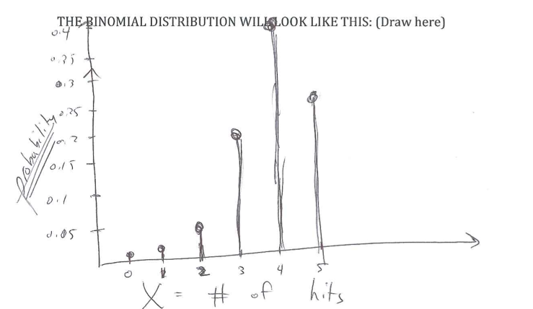
Which makes more sense when graphing

Slide 10
The Binomial Distribution
The expected outcome of the experiment is the population mean:

Slide 11
The Binomial Distribution
If X is the random variable for a binomial experiment with parameters n and p, the we write
Note: The squiggly is read “is distributed as
X(the random variable) is distributed as a binomial with n trials and a probability of success = p.

Slide 12
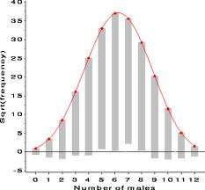
Normally Distributed
Skewed (+ or -)

Slide 13
Graphics Display Calculator
Binomial probability distribution function (binompdf)
Use to find P(X=r) (exactly)
Binomial cumulative distribution function
(binomcdf)
Use to find

