Slide 1
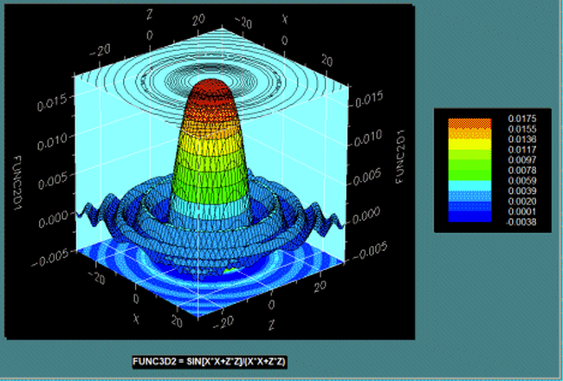
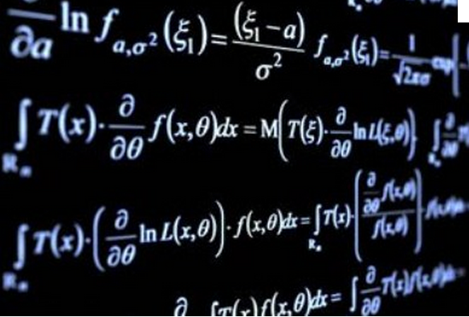
Mathematical Modelling

Slide 3
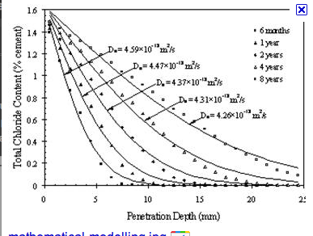
No no…….Mathmatical Modeling!

Slide 6
Mathematical Modelling
Problem solving - often process oriented
Mathematical modeling – often requires an experimental approach

Slide 7
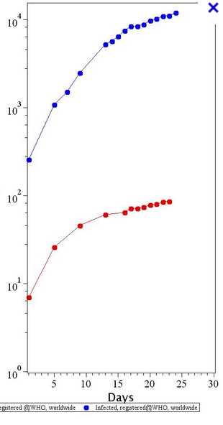
The model should “predict” the near future!

