Slide 1
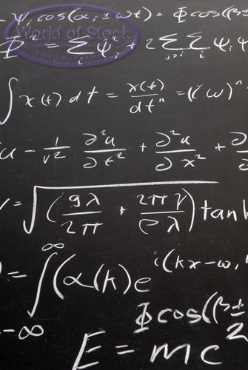
PERIODIC FUNCTIONS

Slide 2
See geo sketch pad
(Note: We work in degrees and radians!!)

Slide 3
Making electricity is easy!

Slide 5
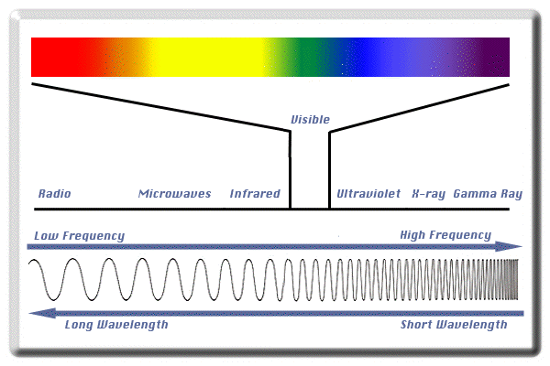

Slide 6
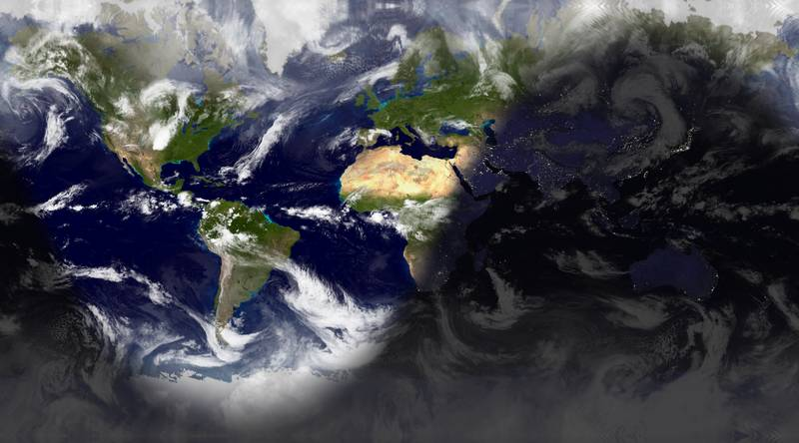

Slide 7
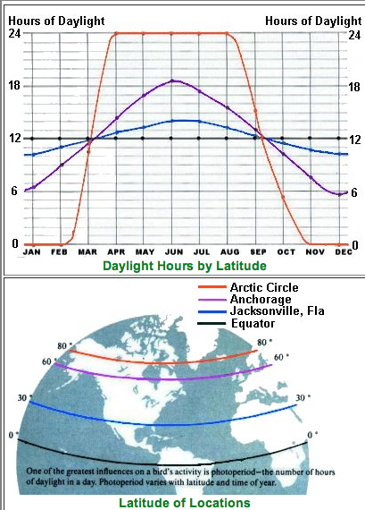

Slide 8
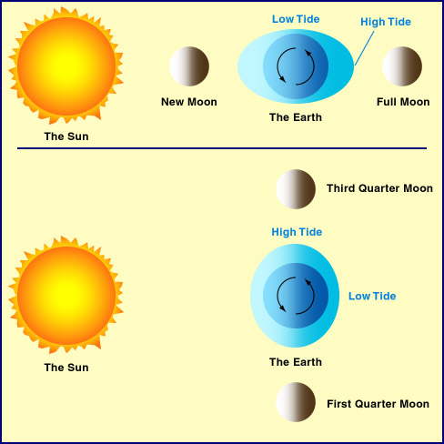

Slide 9
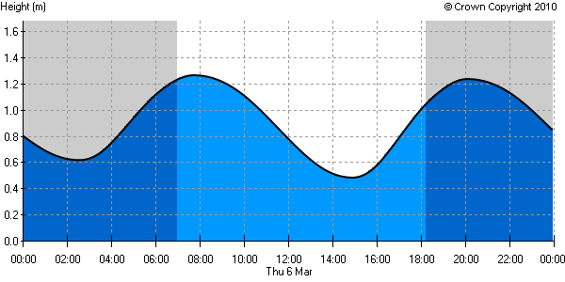

Slide 10
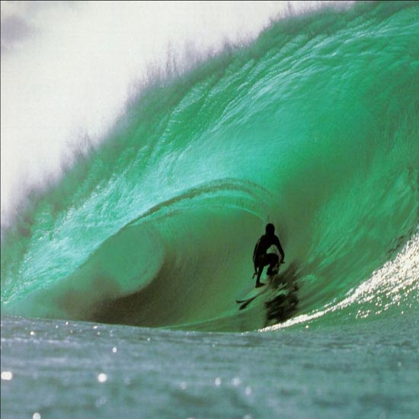
Dude your ridin’
a sine wave!!!

Slide 11
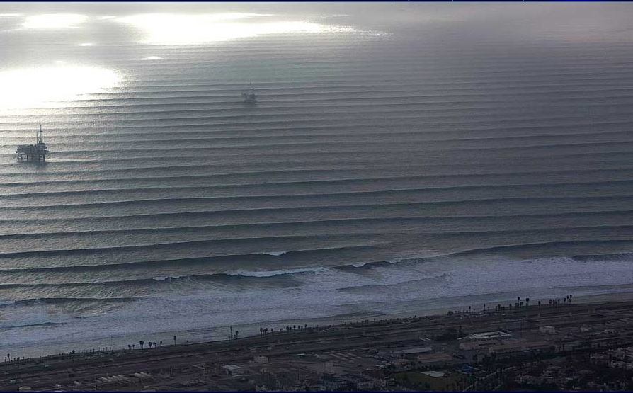

Slide 12
MUSIC!

Slide 14
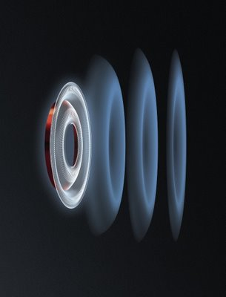
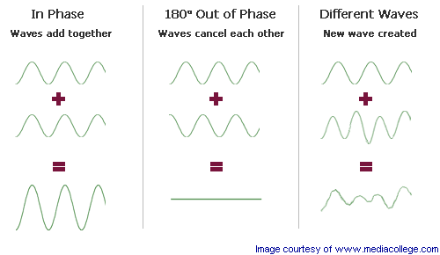

Slide 15
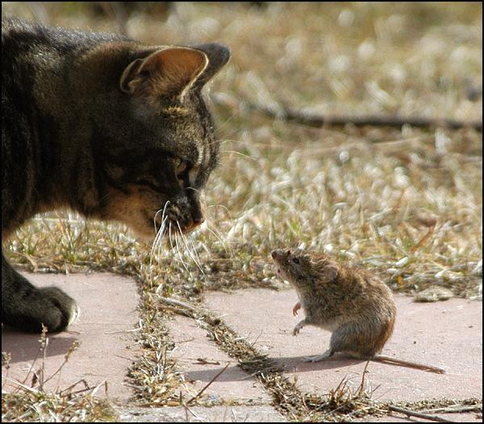
Predator vs. Prey

Slide 16
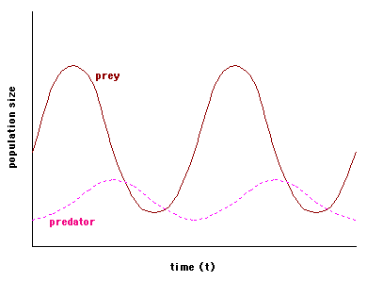

Slide 17
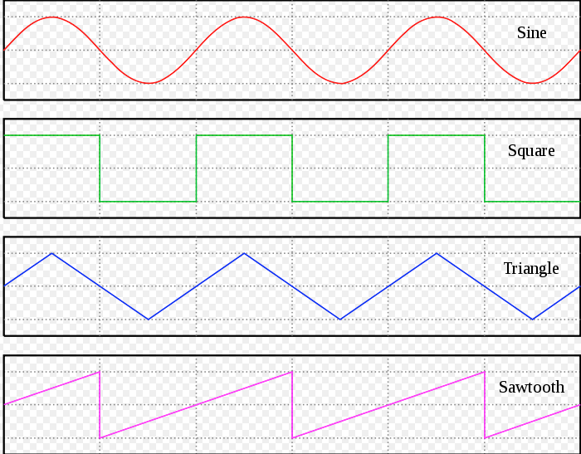
Periodic Waves

Slide 19
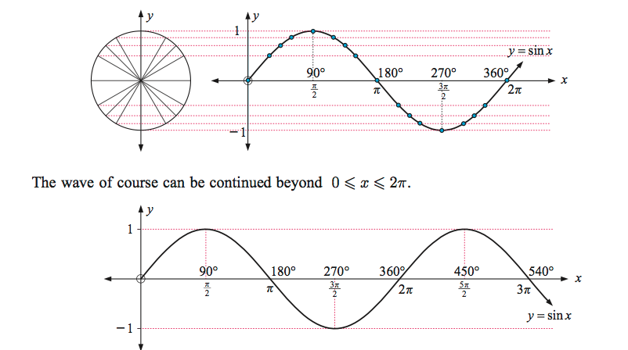

Slide 20
y = Asin(B(x-c))+D
Remember our function transformations!
Af(x)
f(bx)
f(x-c)
f(x)+d

Slide 22
MATHEMATICAL MODELLING!

Slide 23
Finding a function to fit the data

Slide 24
Cool stuff
http://astro.unl.edu/classaction/animations/lunarcycles/tidesim.html
http://www.youtube.com/watch?v=s9GBf8y0lY0
http://www.youtube.com/watch?v=YiHP8EG_Wq4
http://www.youtube.com/watch?v=HpovwbPGEoo
Sine wave animation 3D

